Slide 1

Bits And Bobs Analysis
PREPARED BY: Team Number 1
Manav Arora: c3365762
Erik Dahlberg: c3446439
Lucas Hogan: c3307821
Shamika Fernando: c3387934
Sahil Saggurthi: c3376092

Slide 2
Best salesperson.

Slide 3
Best salesperson by dollars earned monthly
SalespersonName | Office Location
Victoria Cotton | Wollongong
Carlos King | Melbourne
Eli Powell | Hobart
Joey Clark | Adelaide
Samantha Fisher | Hobart
Jake Cox | Wagga Wagga
Taylor Morales | Hobart
Caleb Nguyen | Sydney
Mia Foster | Wagga Wagga
Isaiah Cruz | Adelaide
Marcus Ross | Sydney
Revenue ($)
Salesperson
Month

Slide 4
Top 10 overall best salesperson by dollars earned.
SalespersonName | Office Location
Savannah Jones | Wollongong
Emma Gutierrez | Hobart
Kaitlyn Nguyen | Sydney
Austin Morris | Adelaide
Danielle Myers | Adelaide
Savannah Garcia | Hobart
Mia Foster | Wagga Wagga
Samuel Anderson | Perth
Jenna Cox | Darwin
Jake Cox | Wagga Wagga
Revenue ($)
Salesperson

Slide 5
Best Salesperson by most transactions made (Monthly)
SalespersonName | Office Location
Victoria Cotton | Wollongong
Carlos King | Melbourne
Savannah Jones | Wollongong
Joey Clark | Adelaide
Kate Sanchez | Sydney
Isaiah Powell | Wagga Wagga
Catherine Moore | Sydney
Caleb Nguyen | Sydney
Mia Foster | Wagga Wagga
Vanessa King | Sydney
Sabrina Wright | Perth
Catherine Howard | Sydney
No. of transactions
Salesperson
Month

Slide 6
Top 10 Overall Best salesperson by most transactions made.
No. of Transactions
Salesperson
Location

Slide 7
Best Salesperson by most goods sold (Monthly)
SalespersonName | Office Location
David Gonzalez | Sydney
Carlos King | Melbourne
Zoe Barnes | Brisbane
Joey Clark | Adelaide
Jake Wilson | Wagga Wagga
Isaiah Powell | Wagga Wagga
Allison Campbell | Wagga Wagga
Robert Timson | Newcastle
Mia Foster | Wagga Wagga
Michelle Diaz | Brisbane
Bryan Walker | Darwin
Savannah Jones | Wollongong
No. of Goods sold
Salesperson
Month

Slide 8
Top 10 Overall Best salesperson by most goods sold (monthly)
Quantity
Salesperson
Location

Slide 9
Best and Worst Performing Items

Slide 10
Top 3 Best Performing Items (most popular)
Quantity
Item

Slide 11
Top 3 Worst Performing Items (least popular)
Item

Slide 12
Best Performing Stores

Slide 13
Best performing stores (total revenue made for the company)
Total Quantity
Location

Slide 14
TREND ANALYSIS
Use trends to understand customer behavior

Slide 15
TREND ANALYSIS FOCUSED ON
Seasonality in sales
Effect of Public Holidays on
Total sale amount
Total item quantity amount
Weekly and Monthly customer habits

Slide 16
TREND ANALYSIS FINDINGS
Bits and Bobs exhibit steady streams of customers in relation to:
Number of receipts during weeks and months
Bits and Bobs exhibit steady streams of revenue in relation to:
Seasonality and public holiday

Slide 17
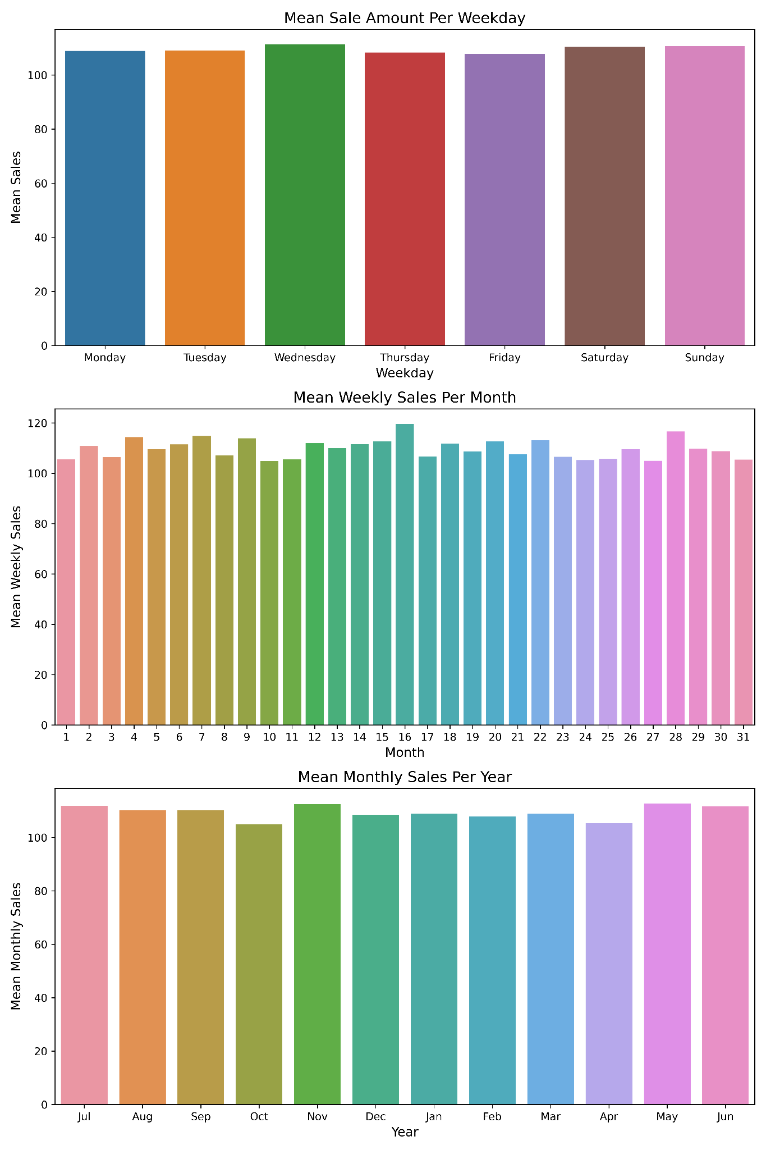
TREND ANALYSIS FINDINGS
Bits and Bobs exhibited an increase in sales during:
November
May

Slide 18
Sales Forecasting
Branch by branch yearly sales projection powered by state of the art AI technology

Slide 19
FORECAST RESULTS
BRANCHES SYDNEY, MELBOURNE, & DARWIN ARE PROJECTED TO INCREASE THEIR MONTHLY REVENUE IN THE COMING 12 MONTHS
ALL OTHER BRANCHES ARE PROJECTED TO DECREASE THEIR MONTHLY REVENUE IN THE COMING 12 MONTHS
BRANCHES WOLLONGONG, WAGGA WAGGA, & ADELAIDE ARE PROJECTED TO LOSE THE MOST OF THEIR TOTAL CURRENT REVENUE

Slide 20
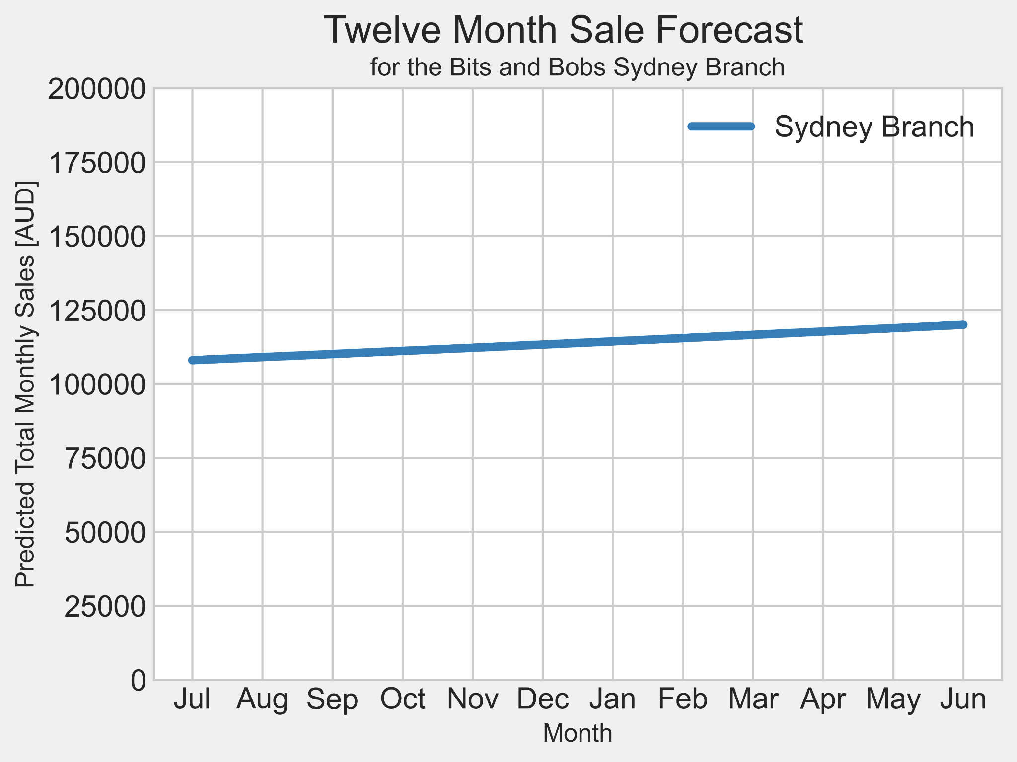
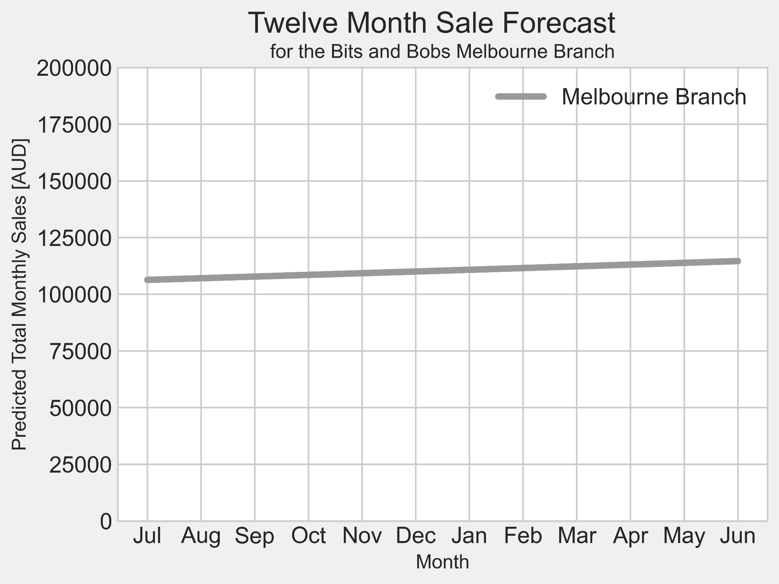
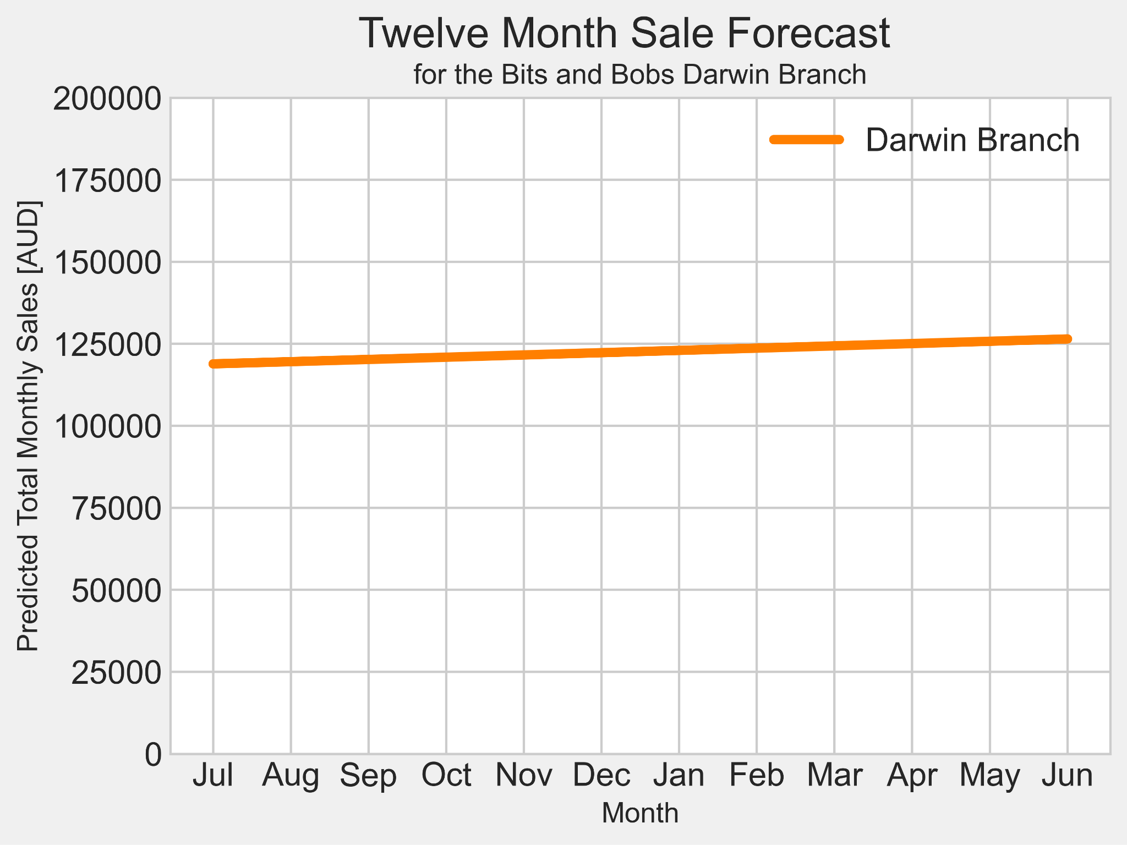
TOP PERFORMERS
SYDNEY
12.000$ projected gain of revenue
12% of current monthly revenue
MELBOURNE
7.000$ projected loss of revenue
6.5% of current monthly revenue
DARWIN
6.000$ projected loss of revenue
5% of current monthly revenue

Slide 21
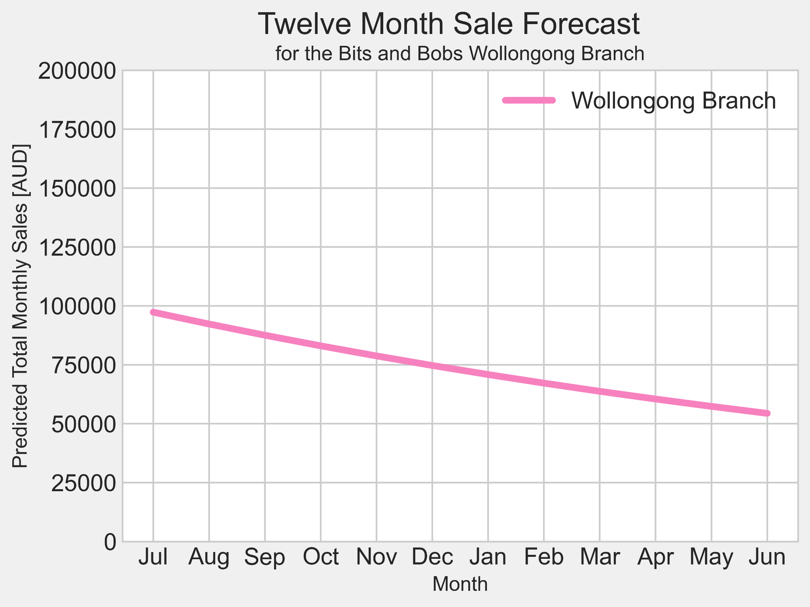
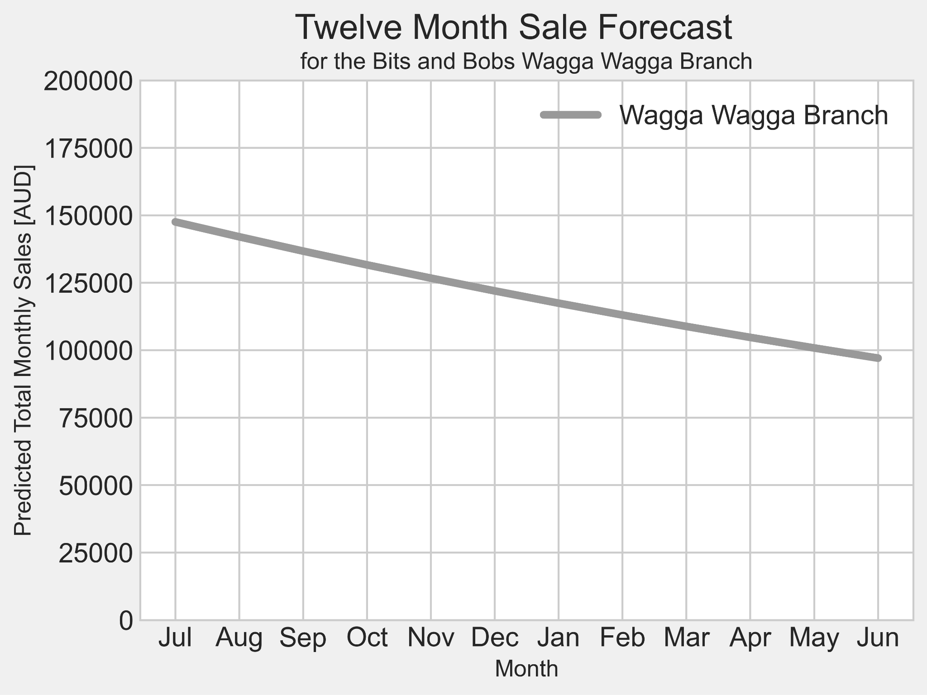
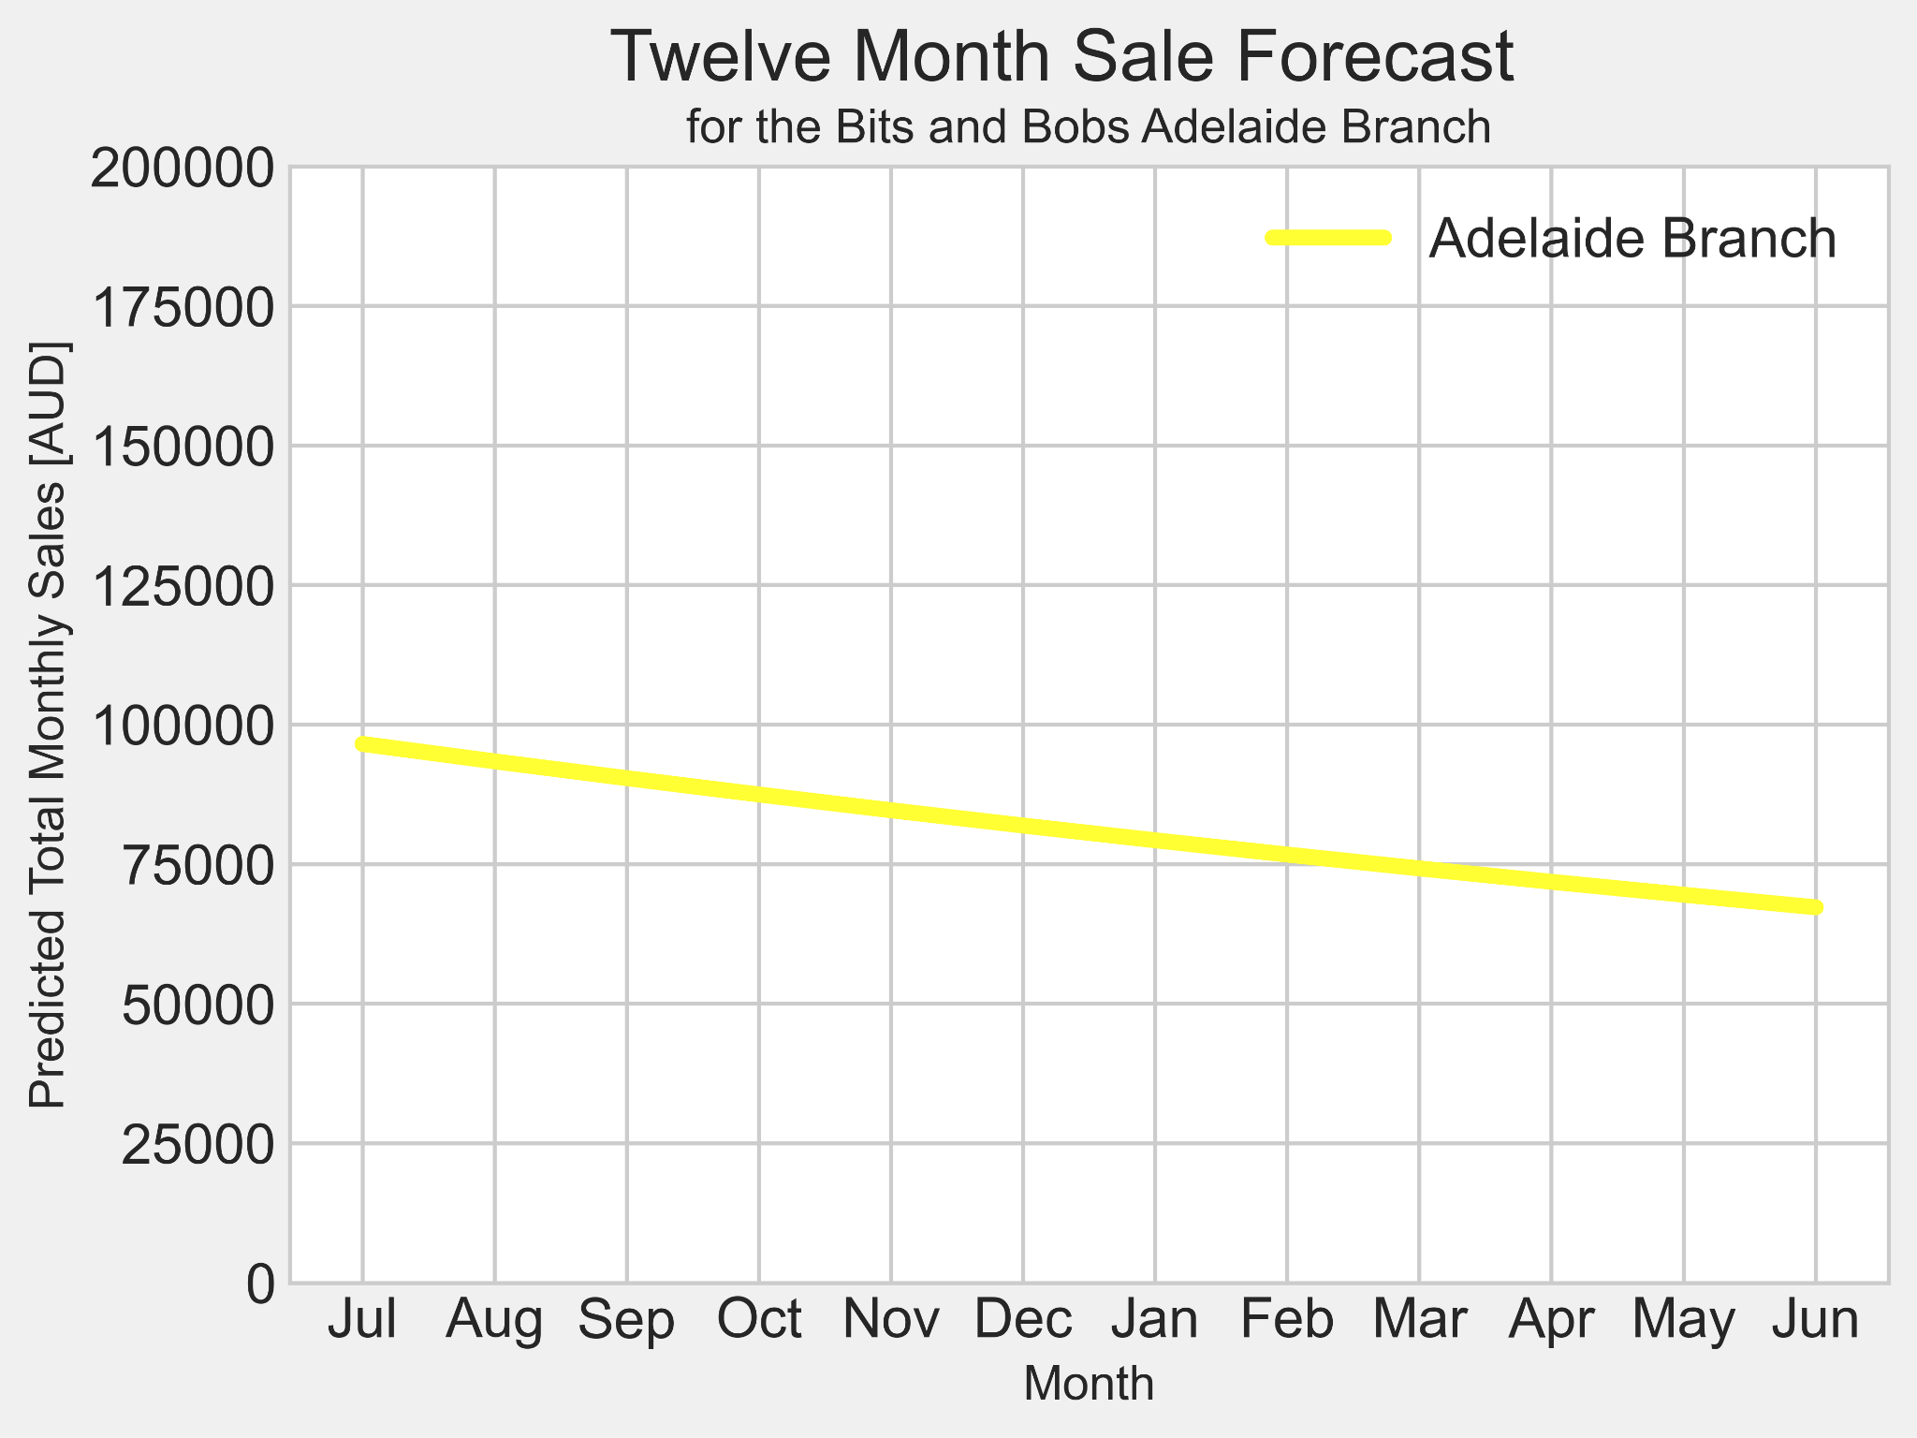
WORST PERFORMERS
WOLLONGONG
43.000$ projected loss of revenue
44% of current monthly revenue
WAGGA WAGGA
50.000$ projected loss of revenue
34% of current monthly revenue
ADELAIDE
33.000$ projected loss of revenue
34% of current monthly revenue

Slide 22
Business Recommendations

Slide 23
Best and worst performing items
Best performing items:
Item 7, Mitre Saw, 20811 Units sold
Item 22, Drill Bit 5mm, 20598 Sold
Item 20, Drill bit 3mm, 20568 Units sold
Worst performing items:
Item 23, Drill Bit 6mm, 19481 Units sold
Item 13, Ruler, 19613 Units Sold
Item 2, Screwdriver set, 19741 Units sold
Key takeaways:
Notice that the gap between best and worst performing items isn’t extreme, withdrawing items isn’t exactly necessary.
Applying discounts or sales to best and worst selling items is beneficial, creates an incentive for customers.
Potential area for bundling items, for example drill bits. This would increase

Slide 24
Recommended store for closure
Based off of our base analysis and predictive analysis, we can confidently say that Wollongong is your worst performing store. It is our recommendation that this is the store for closed.
Wollongong has the:
Least amount of total revenue generated in the past 12 months
Decline of $43 000 over the next 12 months based off predictive analysis
Net profits down by 44% over the next 12 months based off predictive analysis
It is important to mention that Wollongong is the smallest of the 10 stores with only 15 employees. However, based off the statistics of both current and predicted future for Wollongong, it is undoubted that they are your worst performing store.

Slide 25
Visualizing the point system
The idea of the point system is a much better approach than the 12.5% discount previously applied.
With the previous discount applied, the total discounted amount over the 12 month period was $1 172 928.16.
The new point system totals $48 030 of credited dollars over the 12 month period.
Although $48 030 is still a steep amount, providing ongoing incentive to customers through reminders such as email or text on their current points draws customers back to the store.
It is important to also recognise that not all customers will use their points.

Slide 26
Visualizing the point system (cont.)
It is in our opinion that BitsAndBobs tracks their new point system to provide best value for its best customers.
Using the point system as a loyalty tracker to provide incentives for specific reoccurring customers allows for a personalised experience and recognition from the business.
This can be tracked using a tiering system on total revenue generated by each customer.
For example, tiers of bronze, silver and gold status can be applied to customers, the more you spend the higher your tier.
An extremely beneficial business opportunity for BitsAndBob’s would also be to develop an app that allows customers to shop, track their loyalty points, view profile status, see current discounts and sales etc..

Slide 27
Dashboard Link

